Slide 1


SUMMER INTERNSHIP TRAINING HTML5 , CSS & JAVASCRIPT
SHRUTI GUPTA
1803010207

Slide 2

Content:
What is HTML, CSS & JAVASCRIPT?
Basics of HTML
Designing by CSS.
Creating a Web Page.
Syntax and Tags.
Use of Java Script.
FIESA : the beauty store,

Slide 3

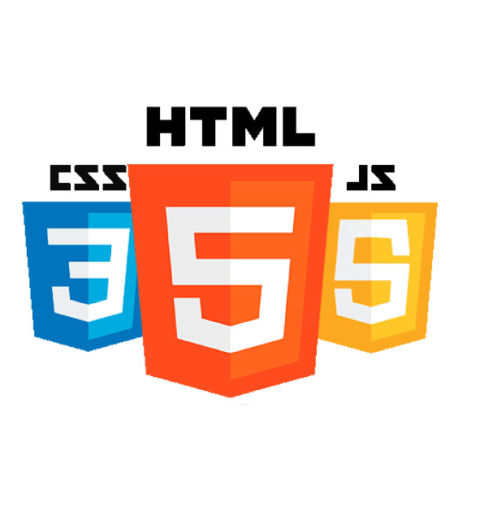
What is HTML, CSS & JAVASCRIPT?
In any web site, HTML provides the basic structure of sites, which is enhanced, modified or beautified by technologies like CSS and JAVASCRIPT....
Where HTML gives base, CSS styles the page and JavaScript decides it's behavior...

Slide 4

Creating a WEB PAGE
Creating a website needs a platform that helps a coder to write code and view. At mordern times the situation of hundereds of website developing apps is changing.
Next one needs a glance of codes. Various websites are giving and teaching basic codes that can be improvised by coder.
Get a domain and launch your website.

Slide 5

HTML
HTML stands for Hyper Text Markup Language. It is not a programming language. It is standard markup Language for documents designed to be displayed on web browser. HTML elements are the building blocks of html or web pages .With html construct, images and other interactive platforms can be added. HTML elements are delineated by help of tags. Tags are placed within angular brackets < > . It also consist of various datatypes, links, attachments that makes it work efficiently. HTML5 is the latest version of html language. It is saved by extensions .html or .htm .

Slide 6

BASICS OF HTML
With HTML you can create your own websites.
HTML is a markup language.
It uses markup language to describe web pages .
It is not case sensitive.
It consist of elements and tags that make is a working site.
This Photo by Unknown author is licensed under CC BY.

Slide 7

TAGS AND SYNTAX OF HTML
TAGS:
Tag | Description
<!DOCTYPE> | Defines the document type
<html> | Defines an HTML document
<head> | Defines information about the document
<title> | Defines a title for the document
<body> | Defines the document's body
<h1> to <h6> | Defines HTML headings
<p> | Defines a paragraph
<br> | Inserts a single line break
<hr> | Defines a thematic change in the content
<!--...--> | Defines a comment

Slide 8
Syntax:
<!DOCTYPE html> <html> <head> <title>Page Title</title> </head> <body> <h1>This is a Heading</h1> <p>This is a paragraph.</p> </body> </html>

Slide 9

CSS
Cascading Style Sheets (CSS) is a style sheet language used for describing the presentation of a document written in a markup language like HTML. CSS is a cornerstone technology of the world wide web, alongside HTML and javascript.CSS is designed to enable the separation of presentation and content, including layout, colors, and fonts.This separation can improve content accessibilty, provide more flexibility and control in the specification of presentation characteristics, enable multiple web pages to share formatting by specifying the relevant CSS in a separate .css file, and reduce complexity and repetition in the structural content.e structural content.

Slide 10
Designing by CSS
CSS (Cascading Style Sheets) is what makes web pages look good and presentable. <!DOCTYPE html> <html> <head> <style> body { background-color: lightblue;} h1 { color: white; text-align: center;
} p { font-family: verdana; font-size: 20px;} </style> </head> </html>

Slide 11
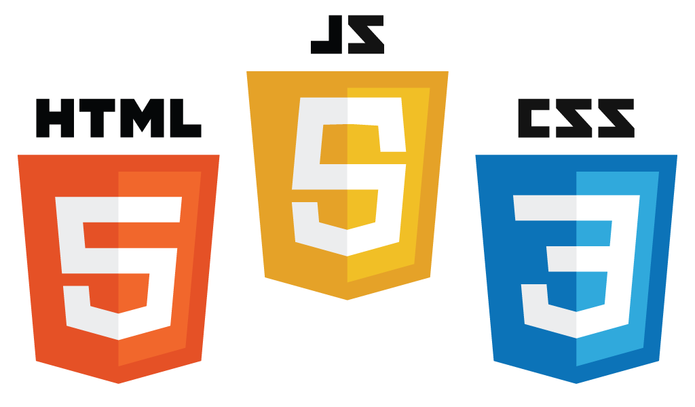
JavaScript
JavaScript is a dynamic computer programming language. It is lightweight and most commonly used as a part of web pages, whose implementations allow client-side script to interact with the user and make dynamic pages. It is an interpreted programming language with object-oriented capabilities.JavaScript was first known as LiveScript, but Netscape changed its name to JavaScript, possibly because of the excitement being generated by Java.We cannot treat JavaScript as a full-fledged programming language.

Slide 12
Use of JAVASCRIPT
Javascript is one of the most used coding languages in present era. SYNTAX:
<script> document.write(“JavaScript is not Java”); </script>
You can place your scripts in any of the following locations: Between the HTML document’s head tags. Within the HTML document’s body (i.e. between the body tags). In an external file (and link to it from your HTML document).

Slide 13

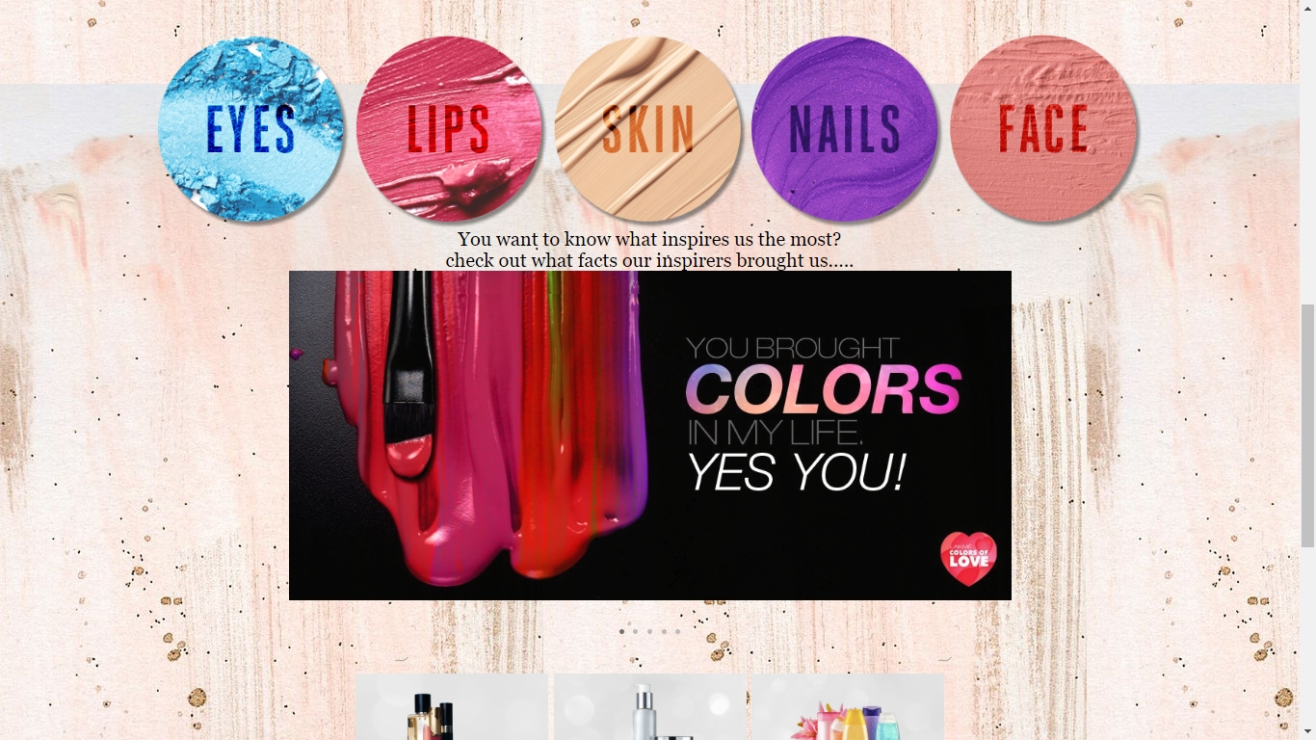
PROJECT
Fiesa: the beauty store
our project was to create a website for beauty products and online shopping…
Here’s a overview of that project… .

Slide 14



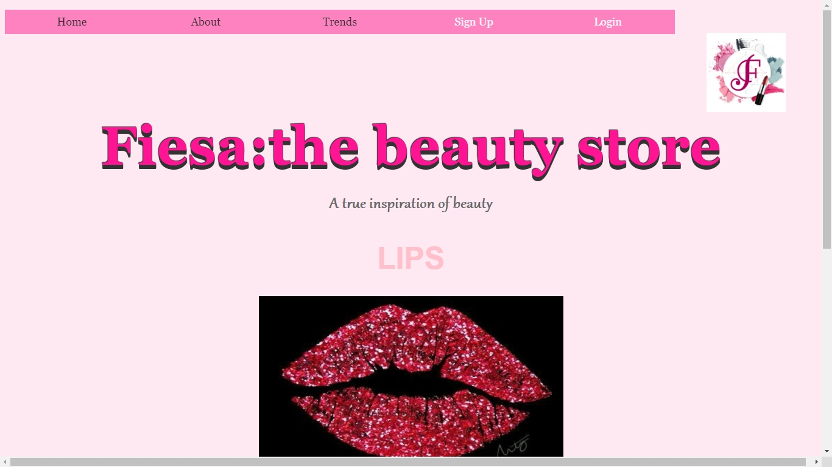

Slide 15

THANK YOU!

